Slide 1
Capital One Hacking
Student Name
Institution Affiliation

Slide 2

Introduction
Most Cybercriminals target financial service industries
Financial institutions have large useful data sets.
The cloud storage of customer data is questionable in financial institutions
Notes:
Cybersecurity remains to be one of the challenges that many organizations are facing, especially with the improved technology. In the efforts to use better technology within the financial institutions, most cybercriminals are now targeting these financial institutions. They are convinced that there is a large array of data that they can obtain from these institutions if their security is compromised. In conjunction, the types of cloud computing used by these institutions are questionable (Schuler, 2019).

Slide 3
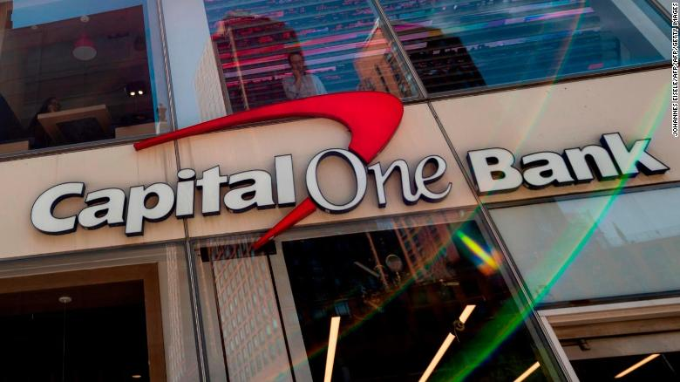
How Capital One was Hacked
Cloud services were unhelpful to protect data compromising
Hacker broke through a misconfigured Capital One Firewall.
Server was easily accessible where customer data was stored.
Notes:
In the past, capital One had adopted the use of cloud servers as a means of ensuring that their customer data was secure. However, during the hacking, the cloud services were unhelpful. Capital One had a misconfigured Capital One firewall, which the hacker used to reach the cloud servers of where information and customer data was being stored (Goodsitt et al., 2019).

Slide 4
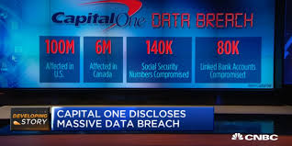
What was Compromised
Roughly 100 million credit card applications.
140,000 social security numbers
80,000 bank account numbers.
Notes:
According to Capital One, the hacker was able to access roughly 100 million credit card applications. Additionally, the federal prosecutor also said that the entire breach included approximately 140,000 social security numbers and 80,000 bank account numbers, which were precisely culled from the millions of credit card applications (Goodsitt et al., 2019).

Slide 5

Personal Data Exposed to the Hacker
Names
Addressees
Date of birth
Credit scores
Transaction data
Social Security numbers
Linked bank account numbers
Notes:
From the compromised data, the hacker was able to access several forms of personal data belonging to the customers. From the credit card applications, names, addresses, date of birth, and bank account numbers were obtained by the hacker. Additionally, credit scores and transaction data was easily accessed by the hacker (Lu, 2019).

Slide 6
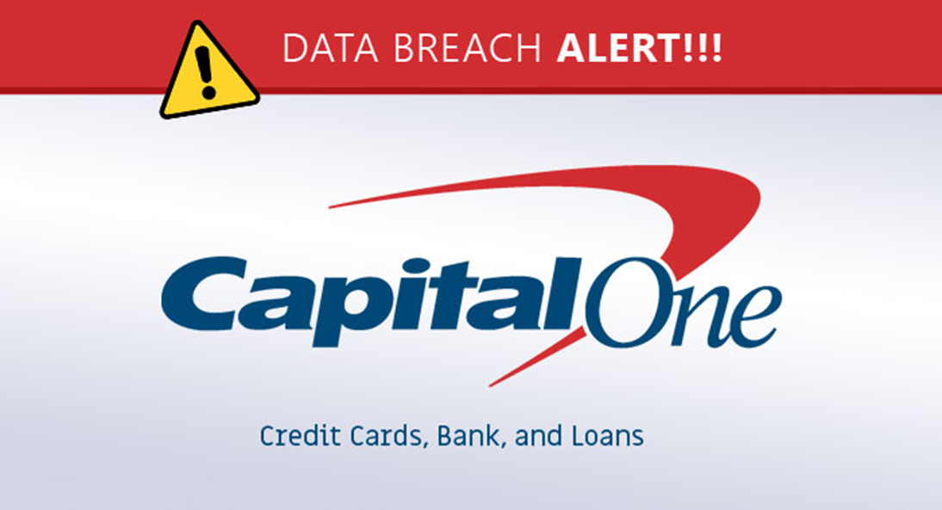
Data Affected
Credit card applications from 2005 to early 2019 from customers.
Notes:
The hacker was able to access the personal information related to the credit applications that customers had made between 2005 and early 2019. This implied that the application that was made before 2005 was not affected by the breaching (Lu, 2019).

Slide 7

When Hacking was Noticed
July 2019
Notes:
The company realized the hacking in July 2019. However, the period when the hacker started breaching capital, one data is not well known. Before the hack, capital one had set up an email address for tipsters to raise the alarm about potential holes in the company’s systems (Goodsitt et al., 2019).

Slide 8

Alert About the Incoming Breach
Email Suggesting leaked data
Notes:
Before the hack, Capital One had received an email suggesting leaked data had shown up on GitHub, a site for collaborating on software code (Lu, 2019).

Slide 9

What Capital One is doing about the Hack
Fixed the exploit used by hacker
Worked closely with federal law enforcement on the breach
Reach out to affected customers
Identity protection of affected customers
Notes:
According to the bank, they have taken and will proceed taking several actions in response to the breach. First, the bank reported that they had fixed the exploit that the hacker used to access the customer data. Additionally, they pointed out that the bank is working closely with federal law enforcement about the breach. Also, the bank said that it would reach to all customers who were affected and offer them free credit monitoring as well as protect their identity (Lu, 2019).

Slide 10

How Capital One Breach Could have been Prevented
Knowing the Bank Insfrastructure
Application of least Privilege model principle
Separation of resources
Notes:
There are various strategies that Capital One could have used to prevent the breach from occurring. First, the bank could have been updated on which users access what and why hence ensuring that no unauthorized person had access to the credit card applications. Also, the bank could provide that any permissions were delegated based on the roles and each role only having access to the resources they need only. Additionally, capital one could have used the cloud virtually unlimited storage space to separate customer information. That is, the WAF and customer information could not have been held in the same bucked (Goodsitt et al., 2019).

Slide 11

How Capital One Breach Could have been Prevented Cont'd
Manage all entities in the bank
Keep infrastructure up to date
Notes:
The bank could have used the developed Cloud Custodian to gather alert about any suspicious activity made by WAF-Role. Additionally, using the WAF solution offered by Amazon, capital one could have been in the position to block suspicious requests before reaching the servers (Lu, 2019).

Slide 12
References
Goodsitt, J. E., Walters, A. G., Abad, F. A. T., Farivar, R., Truong, A., Pham, V., ... & Taylor, K. (2019). U.S. Patent No. 10,263,996. Washington, DC: U.S. Patent and Trademark Office.
Lu, J. (2019). Assessing The Cost, Legal Fallout Of Capital One Data Breach. Legal Fallout Of Capital One Data Breach (August 15, 2019).
Schuler, D. (2019). A hacking atlas: holistic hacking in the urban theater. In The Hackable City (pp. 261-282). Springer, Singapore.

